Slide 1
Castro Brazilia INC data analysis on Brazil Housing
Presented by :
Apoorva Mishra

Slide 2
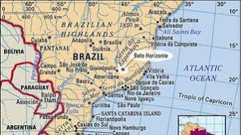
Objective : to find a city in brazil to relocate from rio de Janeiro and sao Paulo USING Exploratory data analysis
Thing to consider !
Whether the person relocating is a bachelor or is one with a family ?
If the person has a family, is it a mid-size(4-6 members) family or a large-size family (7 or more members)
Whether the person owns a pet ?
Spending capacity of a person
Which city provides large areas in less spending

Slide 3
Cities in brazil
1. Porto Alegre
2. Sao Paulo
3. Rio De Janeiro
4. Belo Horizonte
5. Campinas

Slide 4
Part 1 Analysis for a Bachelor / a couple
REQUIREMENTS
1 ROOM
FULLY FURNISHED
PARKING LESS THAN EQUAL TO 1
TOTAL EXPENSE LESS THAN AVERAGE

Slide 5
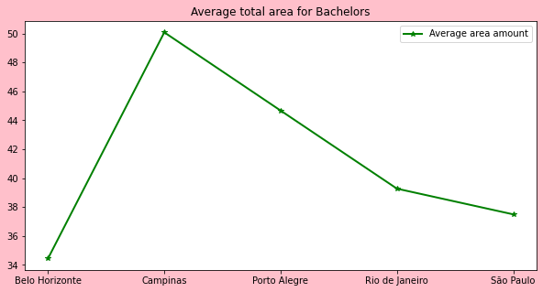
ROOM = 1 ,FULLY FURNISHED, PARKING <=1 TOTAL EXPENSE < AVERAGE
Maximum area = Campinas
Campinas>Porto Alegre>Belo Horizonte
Therefore, Considering area with the above requirement, Campinas will be most efficient city to relocate to.

Slide 6
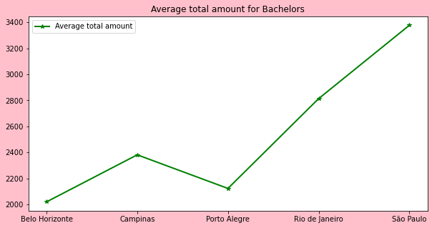
ROOM = 1 ,FULLY FURNISHED, PARKING <=1 TOTAL EXPENSE < AVERAGE
Minimum spending = Belo Horizonte
Belo < Porto Alegre < Campinas
Therefore, Considering total amt with the above requirement, Belo Horizonte will be most efficient city to relocate to.

Slide 7
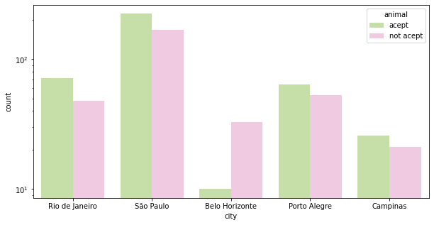
ROOM = 1 ,FULLY FURNISHED, PARKING <=1 TOTAL EXPENSE < AVERAGE For pet owners
After Sao Paulo and Rio De Janerio, Porto Alegre is the most pet friendly city
Therefore, Considering Pet friendly condition with the above requirement, Porto Alegre will be most efficient city to relocate to.

Slide 8
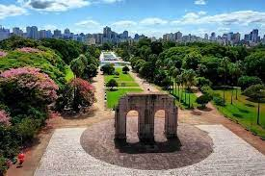
CONCLUSION
Along with all other requisites and considering the maximum area, minimum expenses and spending and pet friendly environment PORTO ALEGRE is the best city to relocate for a bachelor or a single couple

Slide 9
Part 2 Analysis for mid size families
REQUIREMENTS
3 = < ROOM < = 5
3 = < BATHROOM < = 5
3 = < PARKING SPACE < = 5

Slide 10
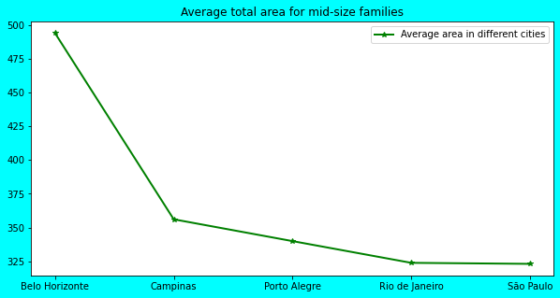
3 = < ROOM < = 5 3 = < BATHROOM < = 5 3 = < PARKING SPACE < = 5
Maximum area = Belo Horizonte
Belo Horizonte> Campinas>Porto Alegre
Therefore, Considering area with the above requirement, Belo Horizonte will be most efficient city to relocate for a mid-size family

Slide 11
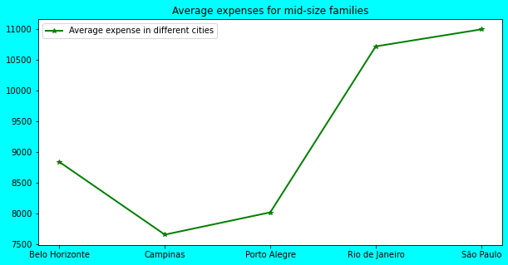
3 = < ROOM < = 5 3 = < BATHROOM < = 5 3 = < PARKING SPACE < = 5
Minimum spending = Campinas
Campinas<Porto Alegre < Belo
Therefore, Considering total amt with the above requirement, Campinas Horizonte will be most efficient city to relocate to.

Slide 12
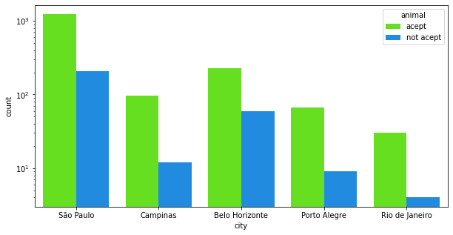
3 = < ROOM < = 5 3 = < BATHROOM < = 5 3 = < PARKING SPACE < = 5
After Sao Paulo, Belo Horizonte the most pet friendly city
Therefore, Considering Pet friendly condition with the above requirement, Belo Horizonte will be most efficient city to relocate to.

Slide 13
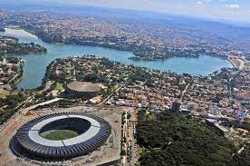
CONCLUSION
Along with all other requisites and considering the maximum area, minimum expenses and spending and pet friendly environment BELO HORIZONTE is the best city to relocate for a mid-size family

Slide 14
Part 3 Analysis for large size families
REQUIREMENTS
ROOM > = 6
BATHROOM > = 6
PARKING SPACE > = 6

Slide 15
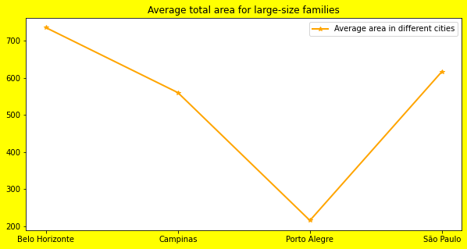
ROOM > = 6 BATHROOM > = 6 PARKING SPACE > = 6
Maximum area = Belo Horizonte
Belo Horizonte> Campinas
Therefore, Considering area with the above requirement, Belo Horizonte will be most efficient city to relocate for a large-size family

Slide 16
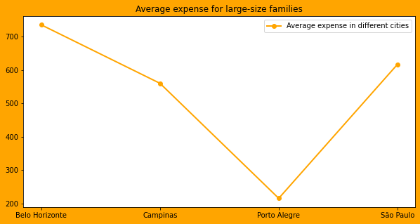
ROOM > = 6 BATHROOM > = 6 PARKING SPACE > = 6
Minimum spending = Porto Alegre
Porto Alegre < Campinas
Therefore, Considering total amt with the above requirement, Porto Alegre Horizonte will be most efficient city to relocate to.

Slide 17
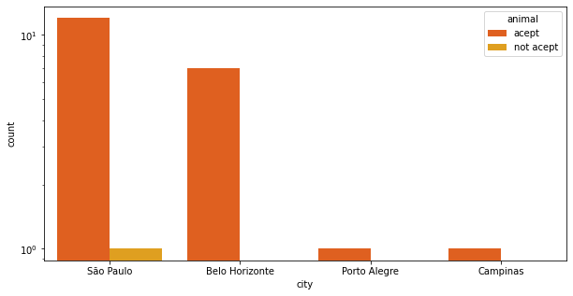
ROOM > = 6 BATHROOM > = 6 PARKING SPACE > = 6 FOR PET OWNERs
After Sao Paulo, Belo Horizonte the most pet friendly city
Therefore, Considering Pet friendly condition with the above requirement, Belo Horizonte will be most efficient city to relocate to.

Slide 18
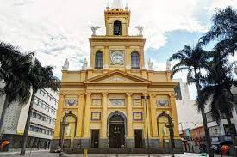
CONCLUSION
Along with all other requisites and considering the maximum area, minimum expenses and spending and pet friendly environment CAMPINAS is the best city to relocate for a large-size family

Slide 19






Overall analysis of different attributes
1. Homeowner Association Tax
2. Rent Amount
3. Property Tax
4. Fire Insurance
5. Total expense/spending

Slide 20
Average values of all the attributes
 |  | city | area | total (R$) | fire insurance (R$) | property tax (R$) | rent amount (R$) | hoa (R$)
 |  | Belo Horizonte | 207.41 | 6315.24 | 53.68 | 272.78 | 3664.13 | 2324.20
 |  | Campinas | 137.56 | 3173.28 | 32.39 | 147.66 | 2364.29 | 628.92
 |  | Porto Alegre | 103.61 | 2989.78 | 36.43 | 124.02 | 2337.70 | 491.62
 |  | Rio de Janeiro | 105.35 | 4611.68 | 42.48 | 256.85 | 3232.90 | 1079.43
 |  | São Paulo | 158.90 | 6380.83 | 62.43 | 495.70 | 4652.79 | 1169.63

Slide 21
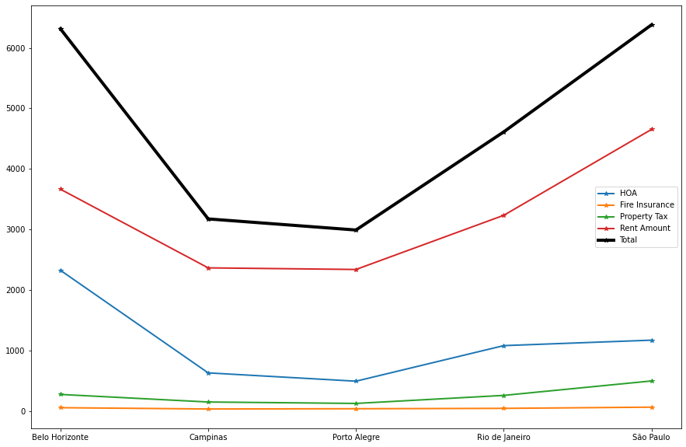
PORTO ALEGRE AND CAMPINAS is the city with least expenses/ spending

Slide 22
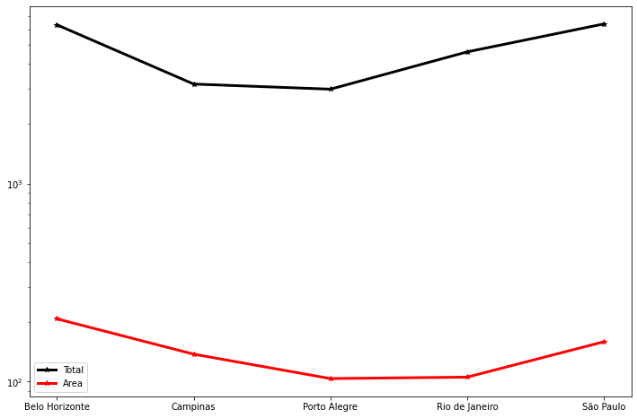
Area vs TOTAl Expense
city | area | total (R$) | Ratio
Belo Horizonte | 207.41 | 6315.24 | 0.03
Campinas | 137.56 | 3173.28 | 0.04
Porto Alegre | 103.61 | 2989.78 | 0.03
Rio de Janeiro | 105.35 | 4611.68 | 0.02
São Paulo | 158.90 | 6380.83 | 0.02
CAMPINAS is the city which gives the best combo of low expenses and high area

Slide 23
THANK YOU !!

